Slide 1
#:#
Normal
7 2
Flash
SCORE
TIME
SCORE
TIME

Slide 2
#:#
#:#
Correct
Incorrect
SCORE
TIME
SCORE
TIME

Slide 3

Old Graphics
settings
menu
Developed by:
Olivia C, 11 years old!
Music
Copyright © Russell Stedman 2013
Thanks to
Mom and Dad,
Ahma,
Chris C,
And all of our beta testers, too!
The object of the game is to copy the pattern that flashed. When you copy it correctly, your score will increase. If you copy it wrong, you will lose a life. When you lose all of your lives, your game ends.

Slide 4
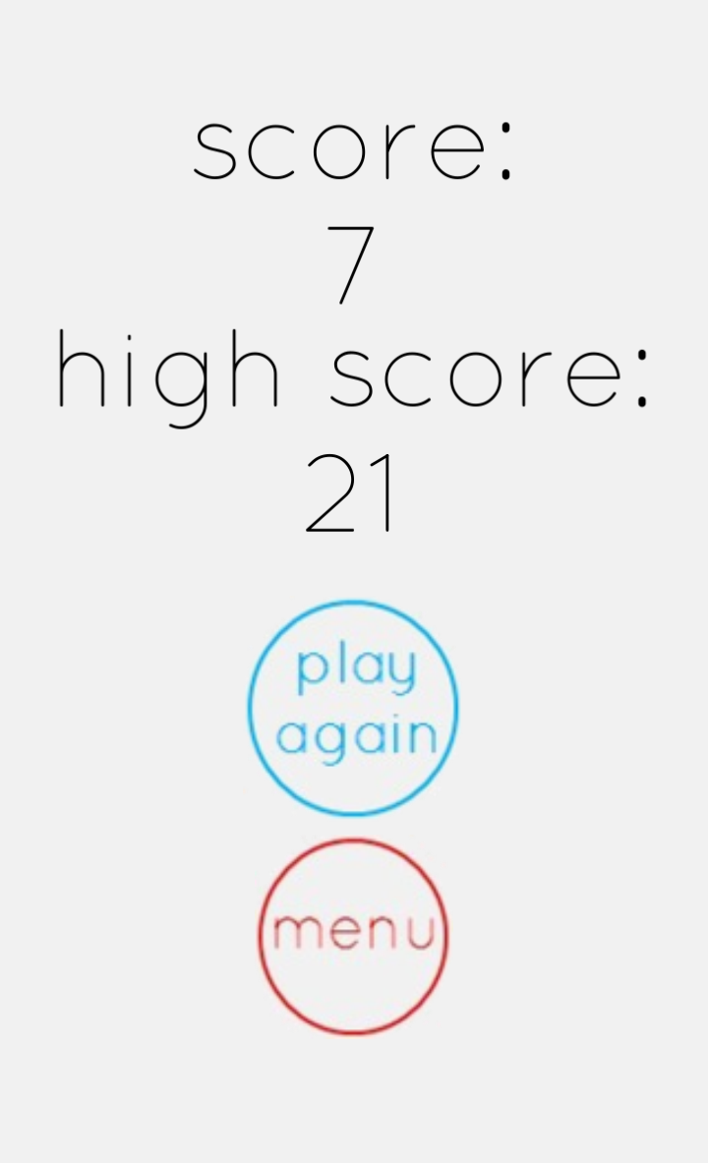
Keep trying to get the highest score!

Slide 5



Settings concept
ON
OFF
Music:
Sound:
ON OFF
ON OFF

